Slide 1
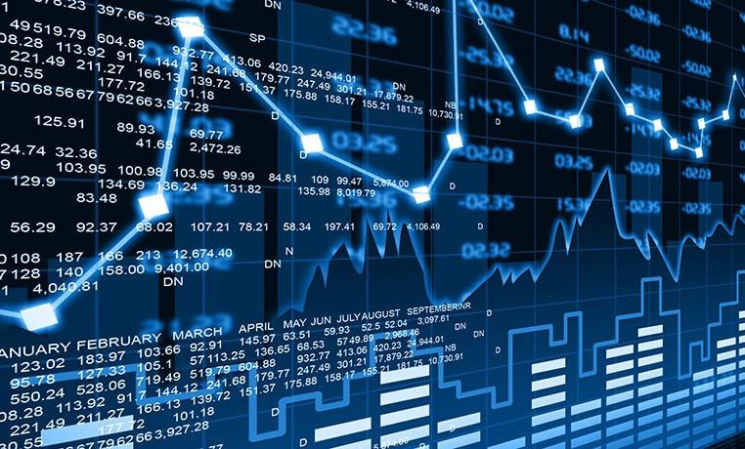
Python Stock Prediction
Presented By: Team 11
- Ishaan Chawla

Slide 2
Introduction of Stock Prediction
Stock market prediction is the act of trying to determine the future value of a company stock or other financial instrument traded on an exchange. The successful prediction of a stock's future price could yield significant profit.

Slide 3
Problem Definition
Most of the people don’t have any knowledge how to invest in stock market.
People invest in stocks with any knowledge of market move or pattern.
Thus result in huge loss of money.
Python prediction model will help whether to invest in particular stock or not.

Slide 4
Dataset Used
The dataset used here is from yahoo finance directly by pandas datareader.
Code Snippet:
import datetime
import pandas_datareader as web
start = datetime.datetime(2010, 1, 1)
end = datetime.datetime(2017, 1, 11)
# Read & display the data for Apple
dfa = web.DataReader("AAPL", 'yahoo', start, end)
dfa.tail(10)

Slide 5
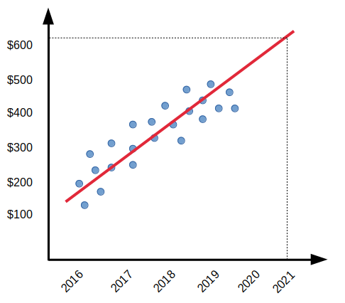
Algorithms used:
Linear Regression: Linear Regression can be considered a Machine Learning algorithm that allows us to map numeric inputs to numeric outputs, fitting a line into the data points.
By this way one can model the relationship between one or more variables.
Working of Linear Regression:
The essence of LR is to find the line that best fits the data
points on the plot,
so that we can, more or less, know exactly where the
predicted value is likely to fall.

Slide 6
K-Nearest Neighbors (KNN)
K-Nearest Neighbors (KNN) is one of the simplest algorithms used in Machine Learning for regression and classification problem. KNN algorithms use data and classify new data points based on similarity measures (e.g. distance function). Classification is done by a majority vote to its neighbors.
Working of KNN:
Determine parameters K as number of nearest neighbours.
Calculate the distance between the query-instance and all the training samples.
Sort values in ascending order based on distance values.
KNN will help to choose the top k rows of sorted array.
KNN will assign a class to the test point based on most frequent class of these rows.

Slide 7
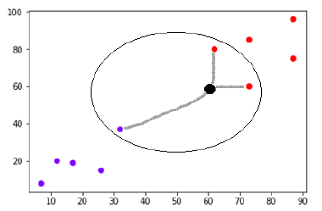
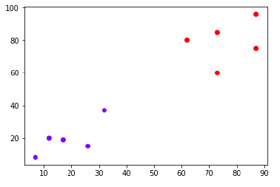

Slide 8
Project Implementation
Importing the data from Yahoo finance.
Data visualization based on features.
Finding the Correlation multiple stocks with each other.
Plotting stocks in terms of risk of buying the stock and selling for profit.
Data Splitting
Model Training & testing
Plotting actual and predicted value
Function cost and accuracy
Model cross validation
Cross validated model accuracy score

Slide 9
Conclusion
There are multiple algorithms for predicting future stock prices.
KNN is better than linear regression when working with scikit learn.
Like Tensorflow, Keras which are widely used in industry for forecast in multiple area like weather, stock prediction, covid 19 prediction, housing cost prediction & much more.
Prediction model is good for long term investment
Apart from these stock market works on emotions no matter how much data can be calculated, plotted, predicted.
Fundamental Analysis — involves the economic factors that influence the price of a stock.
Technical Analysis — this is used to anticipate what other stockholders are thinking based on price and volume of stock being traded.
But cannot predict market crash.

Slide 10
Online References
https://towardsdatascience.com/machine-learning-basics-with-the-k-nearest-neighbors-algorithm-6a6e71d01761#:~:text=KNN%20works%20by%20finding%20the,in%20the%20case%20of%20regression)
https://towardsdatascience.com/machine-learning-basics-with-the-k-nearest-neighbors-algorithm-6a6e71d01761#:~:text=KNN%20works%20by%20finding%20the,in%20the%20case%20of%20regression)
https://www.analyticsvidhya.com/blog/2018/10/predicting-stock-price-machine-learningnd-deep-learning-techniques-python/
https://scikit-learn.org/stable/modules/generated/sklearn.metrics.accuracy_score.html
https://towardsai.net/p/machine-learning/netflix-stock-prediction-model-a-comparative-study-of-linear-regression-k-nearest-neighbor-knn-4527ff17939b

Slide 11
Thank You :)

